Slide 1
CSS
Basic properties of CSS

Slide 2
Agenda
Text Properties
Font & Color Properties
Border Properties
Background Properties
Margin Properties
Padding Properties

Slide 3
Text Properties
Property | Description
direction | Define the text direction/writing direction.
text-align | Sets the horizontal alignment of inline content.
text-decoration | Specifies the decoration added to text.
text-decoration-line | Specifies what kind of line decorations are added to the element.
Text-decoration-color | Specify color to decoration
text-indent | Indent the first line of text.
text-shadow | Applies one or more shadows to the text content of an element.
text-transform | Transforms the case of the text.
letter-spacing | Sets the extra spacing between letters.
word-spacing | Sets the spacing between words.

Slide 4
Font & Color Properties
Font Property | Description
font | Defines a variety of font properties within one declaration.
font-family | Defines a list of fonts for element.
font-size | Defines the font size for the text.
font-style | Defines the font style for the text.
font-variant | Specify the font variant.
font-weight | Specify the font weight of the text.
Color Property | Description
color | Specify the color of the text of an element.
opacity | Specifies the transparency of an element.

Slide 5

Border Properties
Property | Description
border | Sets the width, style, and color for all four sides of an element's border.
border-bottom | Sets the width, style, and color of the bottom border of an element.
border-bottom-color | Sets the color of the bottom border of an element.
border-bottom-left-radius | Defines the shape of the bottom-left border corner of an element.
border-bottom-right-radius | Defines the shape of the bottom-right border corner of an element.
border-bottom-style | Sets the style of the bottom border of an element.
border-bottom-width | Sets the width of the bottom border of an element.
border-color | Sets the color of the border on all the four sides of an element.
border-left | Sets the width, style, and color of the left border of an element.
border-left-color | Sets the color of the left border of an element.
border-left-style | Sets the style of the left border of an element.
border-left-width | Sets the width of the left border of an element.
border-radius | Defines the shape of the border corners of an element.
border-right | Sets the width, style, and color of the right border of an element.
border-right-color | Sets the color of the right border of an element.
border-right-style | Sets the style of the right border of an element.
border-right-width | Sets the width of the right border of an element.
border-style | Sets the style of the border on all the four sides of an element.
border-top | Sets the width, style, and color of the top border of an element.
border-top-color | Sets the color of the top border of an element.
border-top-left-radius | Defines the shape of the top-left border corner of an element.
border-top-right-radius | Defines the shape of the top-right border corner of an element.
border-top-style | Sets the style of the top border of an element.
border-top-width | Sets the width of the top border of an element.
border-width | Sets the width of the border on all the four sides of an element.

Slide 6
Background Properties
Property | Description
background | Defines a variety of background properties within one declaration.
Background-attachment | Specify whether the background image is fixed in the viewport or scrolls.
background-color | Defines an element's background color.
background-image | Defines an element's background image.
background-origin | Specifies the positioning area of the background images.
background-position | Defines the origin of a background image.
background-repeat | Specify whether/how the background image is tiled.
background-size | Specifies the size of the background images.

Slide 7
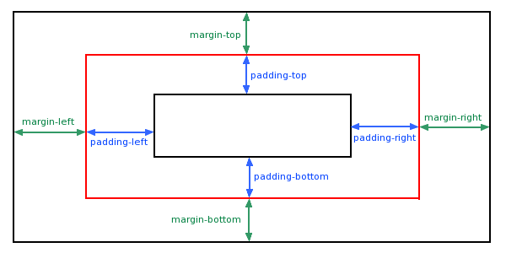
Margin Properties
Property | Description
margin | Sets the margin on all four sides of the element.
margin-bottom | Sets the bottom margin of the element.
margin-left | Sets the left margin of the element.
margin-right | Sets the right margin of the element.
margin-top | Sets the top margin of the element.

Slide 8
Padding Properties
Property | Description
padding | Sets the padding on all four sides of the element.
padding-bottom | Sets the padding to the bottom side of an element.
padding-left | Sets the padding to the left side of an element.
padding-right | Sets the padding to the right side of an element.
padding-top | Sets the padding to the top side of an element.

Slide 9
Summary & Report
CSS is a Cascading Style sheet used for provide formatting to html element
Syntax of CSS: Selector and Declaration
Applying different text properties such as : direction, break etc.
Applying different font properties such as : font-family, font-weight etc.
Changing or Applying the border on any element.
Applying background on any element
Learned how to apply margin and padding on any element

Slide 10
THANK YOU

